Slide 1
LED Driving Basics
(for non-CCC type displays)
By John Khalaf
5-12-2016

Slide 2
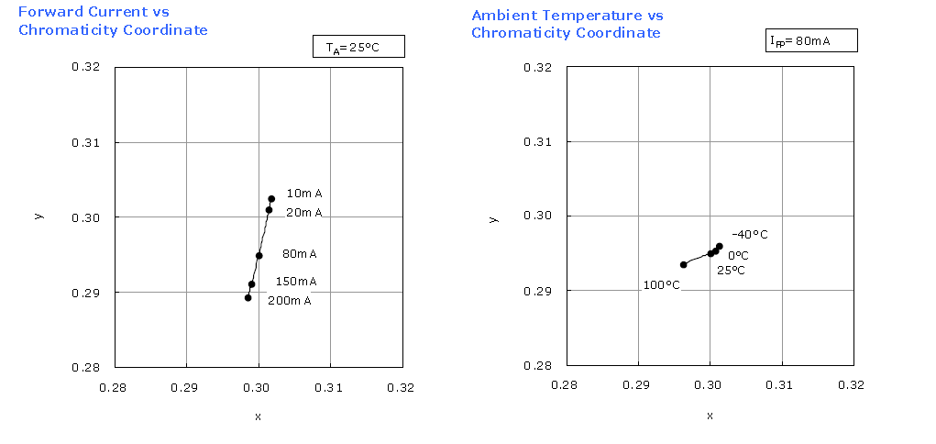
Effects to LCD backlight Chromaticity based on temperature and current variations
The less current through the LED, the more “yellow” the output light. The more current, the more “blue” the output light.
The colder the LED, the more “yellow” the output light. The hotter the LED, the more “blue” the output light.

Slide 3
Drive the LED’s with a square wave at the rated LED typical current.*
Adjust the PWM signal (duty cycle on-time) to vary backlight intensity.
A1
A2
50% duty
25% duty
C2
C1
10% duty
*For direct drive LED strings (non-CCC type).
For best performance, it is suggested to maintain constant current through the LED strings and vary only the width of the pulses. (Varying the current will affect the color temperature of the LED light output.) See previous slide.

Slide 4
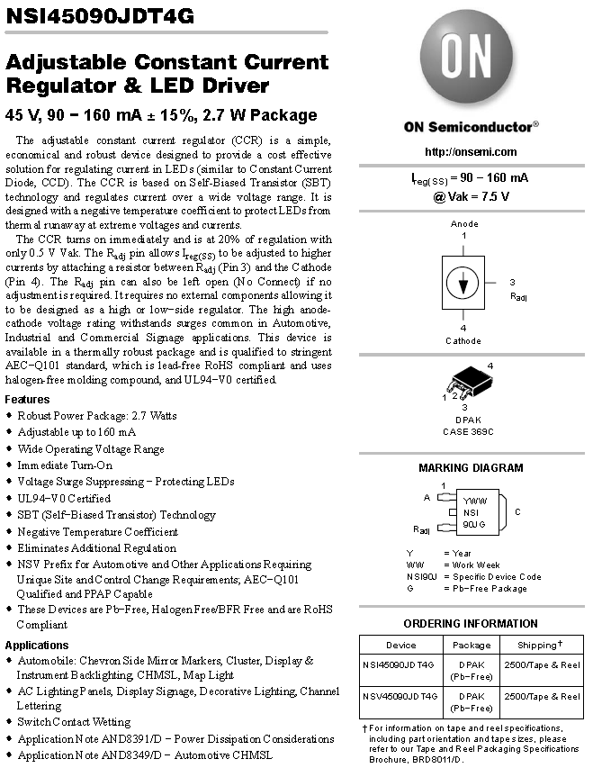
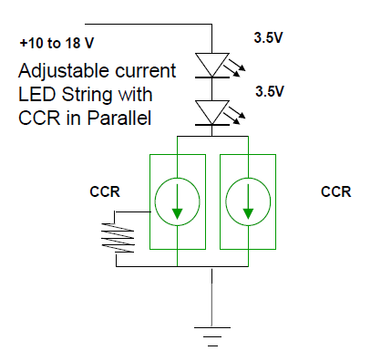
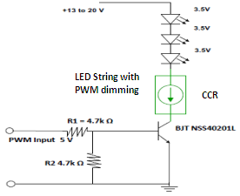
Example 1 of a Constant Current LED drivers.
Use 2 or more CCR’s in parallel to increase the current in the string
3 terminal CCR
(adjustable current)
2 terminal CCR
(fixed current)
2 or 3 terminal
CCR’s can be used to drive
LED strings

Slide 5
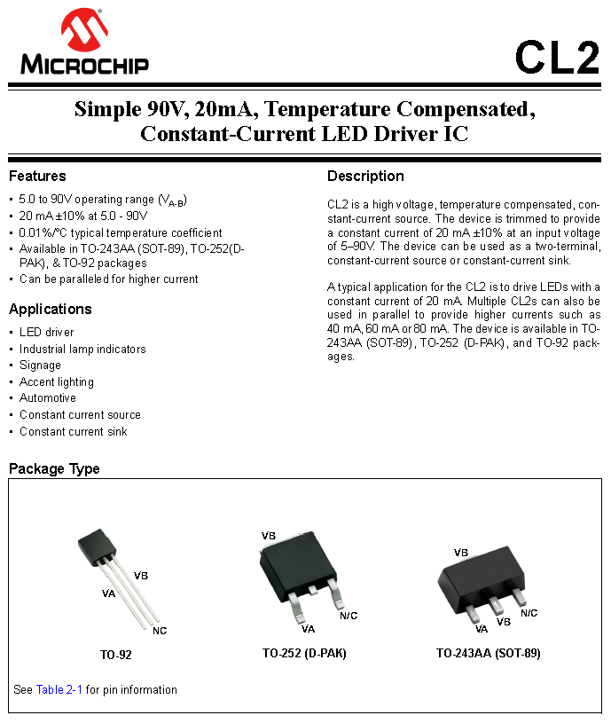
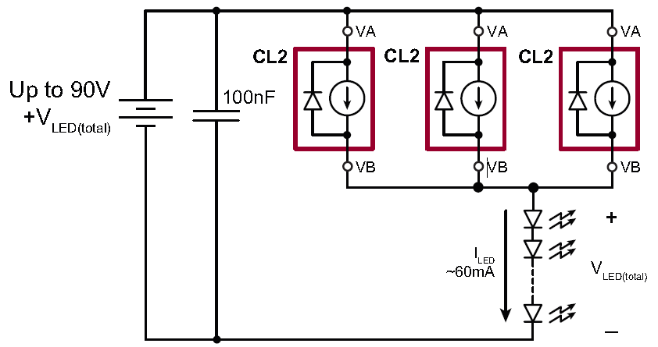
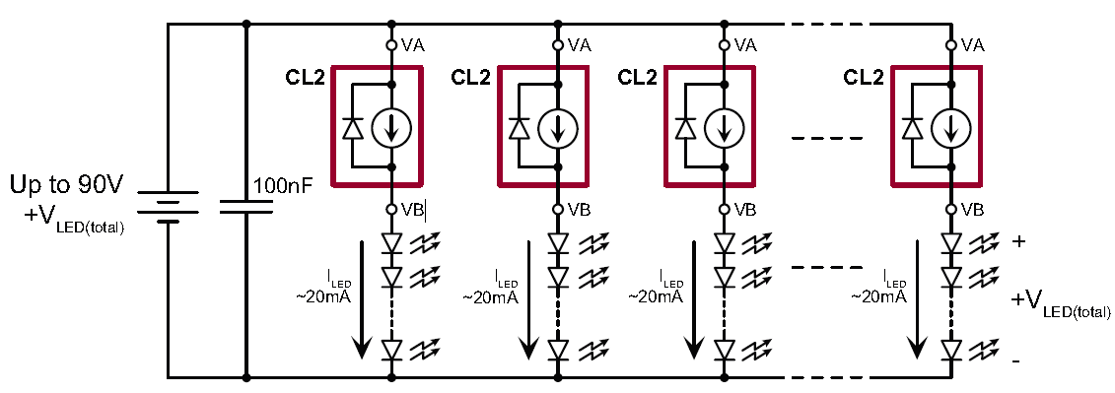
Example 2 of a Constant Current LED drivers.
Multiple devices in parallel to increase the current in 1 LED string
Multiple devices (1 per LED string)

